Slide 1
Advanced Machine Learning Model for Customer Segmentation in Retail
Premchand M
Kasthur Reddy Paddarthi Saint Peter’s University Ds630 Instructor February 14, 2024

Slide 2
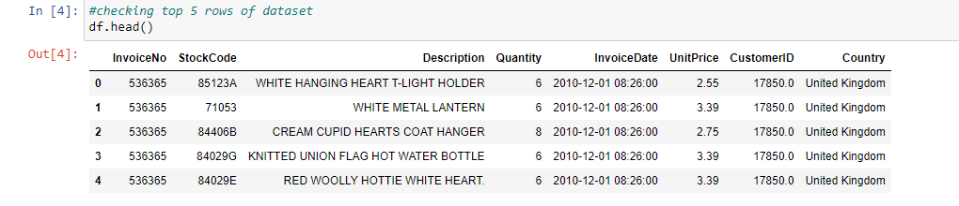
Data Preprocessing and Exploratory Data Analysis
Data Preview Report
The dataset under consideration comprises essential columns such as InvoiceNo, StockCode, Description, Quantity, InvoiceDate, UnitPrice, CustomerID, and Country.
This dataset meticulously records retail transactions, capturing details of individual purchases, product descriptions, and customer information.
A preliminary examination is crucial to comprehend the dataset's structure and content, laying the groundwork for a more in-depth analysis.
Through exploratory data analysis (EDA), patterns, trends, and potential outliers are identified, providing valuable insights and guiding subsequent analytical strategies.
Notes:
In this presentation, I will be looking at dataset for our analysis which contains key columns like InvoiceNo, StockCode, Description, Quantity, InvoiceDate, UnitPrice, CustomerID, and Country. These columns hold vital information regarding retail transactions, offering a detailed record of individual purchases, product descriptions, and customer data. A preliminary examination is indispensable to grasp the dataset's structure and content, forming the basis for our in-depth analysis. Through exploratory data analysis (EDA), we aim to uncover patterns, trends, and potential outliers in the data. This process is crucial as it not only provides valuable insights but also serves as a guide for our subsequent analytical strategies, ensuring a well-informed and comprehensive approach to our data exploration and interpretation.

Slide 3
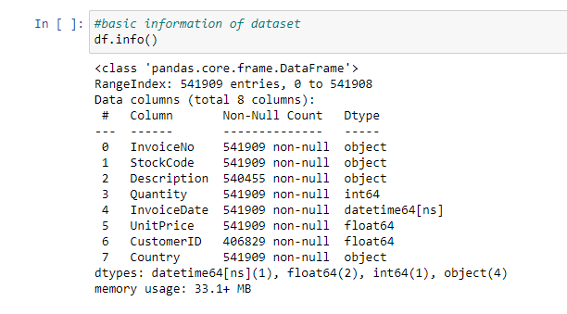
Dataset Information Report
The dataset encompasses 541,909 entries, indicating a substantial volume of data for analysis.
Overall completeness is high, with a majority of fields being non-null, signifying good data quality.
Noteworthy is the presence of gaps in the 'CustomerID' column, a crucial element for effective customer segmentation efforts.
Data types exhibit diversity, including objects, integers, floats, and datetime formats, offering a broad range of opportunities for analysis, from exploring temporal trends to understanding customer purchasing patterns.
Notes:
In this presentation slide, I will be discussing key aspects of our dataset. Firstly, it consists of an impressive 541,909 entries, highlighting a substantial volume for our analysis. The overall completeness is commendable, with a majority of fields being non-null, indicating a high level of data quality. However, a critical observation is the presence of gaps in the 'CustomerID' column, which is pivotal for our customer segmentation efforts. This gap will need careful consideration during our data preprocessing phase. Additionally, the dataset showcases diversity in data types, encompassing objects, integers, floats, and datetime formats. This diversity opens up a plethora of opportunities for analysis, ranging from exploring temporal trends to gaining insights into customer purchasing patterns. These observations lay the foundation for our analytical journey and will guide our subsequent steps in understanding and extracting meaningful insights from the data.

Slide 4
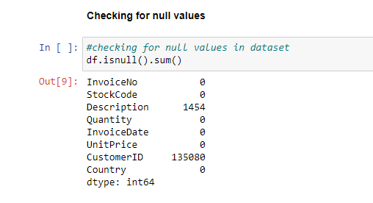
Data Cleaning Report
Identified null values in 'Description' (1,454) and 'CustomerID' (135,080) columns.
Mitigation: Removed incomplete rows to maintain dataset integrity.
Outcome: Post-cleaning, no null values remain, making the dataset ready for preprocessing.
Importance: This step strengthens the foundation for a reliable and accurate segmentation model.
Notes:
In this presentation slide, I will be discussing a crucial data preprocessing step undertaken to ensure the integrity of our dataset. Initially, we identified null values in the 'Description' and 'CustomerID' columns, with 1,454 and 135,080 missing entries, respectively. To address this, we opted for a proactive mitigation strategy by removing the incomplete rows. Post-cleaning, the dataset underwent a transformation, with no remaining null values. This meticulous process was instrumental in preparing the dataset for subsequent preprocessing steps and analyses. The importance of this step lies in its contribution to strengthening the foundation for a reliable and accurate segmentation model, ensuring that our future analyses are built upon a clean and robust dataset.

Slide 5
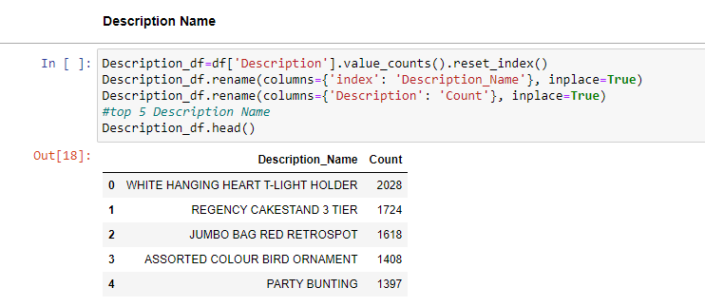
Exploratory data analysis
Top Selling Products Analysis
In the analysis of product popularity, a dataframe was generated to count occurrences of each product description, with columns named 'Description_Name' and 'Count' for clarity.
Notable Findings:
The most popular product is 'WHITE HANGING HEART T-LIGHT HOLDER' with 2,028 sales.
Other top sellers include 'REGENCY CAKESTAND 3 TIER' and 'JUMBO BAG RED RETROSPOT.'
Trends Indicated: Customer preferences show a trend towards home décor and storage items.
Implications:
Valuable insights for inventory management and marketing strategies.
Highlights the most attractive products for the customer base.
Notes:
In this presentation slide, I will be highlighting key insights from our top-selling products analysis. To conduct this analysis, we generated a dataframe, categorizing each product by occurrences, with columns clearly named 'Description_Name' and 'Count' for transparency. Notably, the most popular product identified was the 'WHITE HANGING HEART T-LIGHT HOLDER,' boasting an impressive 2,028 sales. Additionally, 'REGENCY CAKESTAND 3 TIER' and 'JUMBO BAG RED RETROSPOT' emerged as other top sellers. A discernible trend was observed in customer preferences, leaning towards home décor and storage items. The implications of these findings extend to valuable insights for effective inventory management and the formulation of targeted marketing strategies. Moreover, the identification of the most attractive products serves as a strategic guide for catering to the preferences of our customer base, potentially influencing purchasing decisions and enhancing overall customer satisfaction.

Slide 6
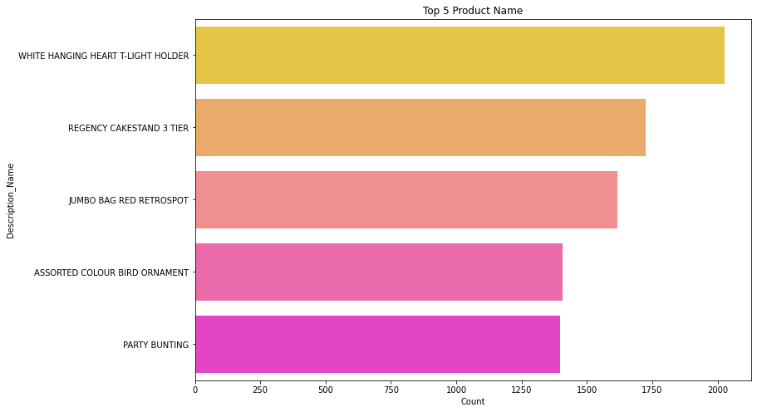
Product Popularity Visualization
Utilized a horizontal bar chart to visually depict the popularity of products.
Objective: Quickly identify the most popular items.
Visualization Features:
Distinct colors for each product for easy differentiation.
Bar length represents relative popularity.
Noteworthy Insight:
'WHITE HANGING HEART T-LIGHT HOLDER' prominently stands out.
Importance of Visualization:
Essential for accessible data presentation.
Facilitates more informed, data-driven strategic decisions.
Notes:
In this presentation slide, I will be discussing our approach to visually depicting product popularity using a horizontal bar chart. The primary objective behind this visualization was to swiftly identify the most popular items within our dataset. The chart was designed with distinct colors assigned to each product, ensuring easy differentiation and enhancing visual clarity. The length of the bars served as a direct representation of the relative popularity of each item. Notably, the 'WHITE HANGING HEART T-LIGHT HOLDER' prominently stood out as the most popular product. The importance of this visualization lies in its role as an essential tool for presenting data in an accessible format, enabling stakeholders to make more informed, data-driven strategic decisions. By providing a visual representation of product popularity, this approach facilitates a quick understanding of customer preferences and can guide future marketing and inventory management strategies.

Slide 7
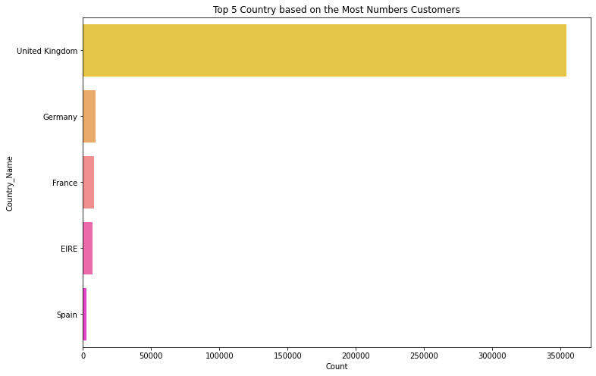
Least Selling Product Analysis
Identified least popular products like 'RUBY GLASS CLUSTER EARRINGS' and 'PINK CHRYSANTHEMUMS ART FLOWER' with only one sale each.
Significance: Crucial for decision-making on product lines—considering discontinuation or re-evaluation.
Exploration Focus: Investigating poor performance, exploring factors from pricing issues to market trends or visibility concerns.
Notes:
In this presentation slide, we'll delve into our findings regarding the least popular products in our analysis, exemplified by items such as 'RUBY GLASS CLUSTER EARRINGS' and 'PINK CHRYSANTHEMUMS ART FLOWER,' each with only one sale. The significance of this discovery is paramount, as it provides crucial insights for decision-making on product lines. The consideration may involve contemplating the discontinuation or re-evaluation of these less-popular items. Our exploration focus shifts towards investigating the factors contributing to their poor performance. This involves a thorough examination of potential issues such as pricing, market trends, and visibility concerns. By understanding the reasons behind their low sales, we aim to inform strategic decisions that could optimize our product offerings and enhance overall business performance.

Slide 8
Feature Engineering
Feature Engineering:
Derived new features (Month, Day, Hour) from the InvoiceDate column for finer transaction timing details.
Created TotalAmount feature (Quantity * UnitPrice) to measure transaction value.
Exploratory Data Analysis (EDA):
Investigated transaction distribution across monthly, daily, and hourly timescales.
Objective: Uncover patterns and trends in customer purchasing behavior.
Insights Sought:
Identification of peak shopping times and seasonal variations.
Critical for informed decision-making and targeted marketing strategies.
Notes:
In this presentation segment, let's focus on our feature engineering and exploratory data analysis efforts. Firstly, in the feature engineering phase, we derived new features - Month, Day, and Hour - from the InvoiceDate column to capture finer details regarding transaction timing. Additionally, we created a TotalAmount feature by multiplying Quantity and UnitPrice to measure transaction value accurately. Shifting to exploratory data analysis (EDA), we delved into the distribution of transactions across monthly, daily, and hourly timescales. Our primary objective here was to uncover patterns and trends in customer purchasing behavior. We specifically sought insights into peak shopping times and seasonal variations, as these findings are critical for making informed decisions and formulating targeted marketing strategies. By understanding the temporal dynamics of our transactions, we are better equipped to align our business operations and promotional activities with customer preferences and behaviors over time.

Slide 9
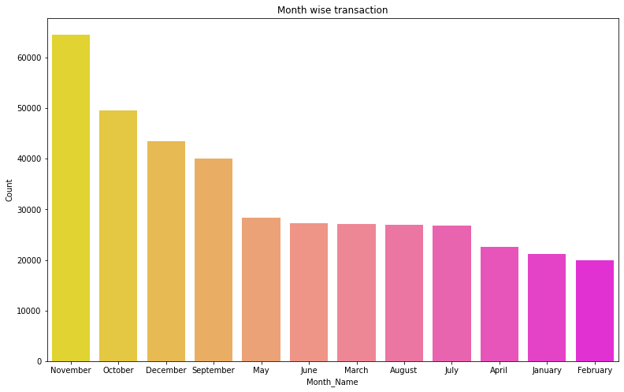
Customer Purchase Over Months
The bar chart in the feature engineering section illustrates customer purchasing patterns over different months.
Taller bars in November, October, and December signify increased purchases, correlating with festive seasons and New Year celebrations.
These months are crucial for the company, indicating high demand from wholesale customers preparing for the season.
Conversely, shorter bars in April and February suggest minimal purchasing activity during these months.
Insights from this analysis guide stock planning, marketing efforts, and sales promotions to align with customer buying behavior throughout the year.
Notes:
In this part of the presentation, let's focus on the insights derived from our feature engineering analysis, particularly the bar chart illustrating customer purchasing patterns over different months. Notably, the taller bars in November, October, and December stand out, signifying increased purchases that align with festive seasons and New Year celebrations. These months emerge as crucial for the company, indicating a high demand likely driven by wholesale customers preparing for the seasonal rush. Conversely, the shorter bars in April and February suggest minimal purchasing activity during these months. These observations hold significant implications for our business strategy. The insights gained from this analysis will guide our stock planning, marketing efforts, and sales promotions, allowing us to align these activities strategically with customer buying behavior throughout the year. By understanding the seasonal trends, we can optimize our operations to meet heightened demand during peak periods and enhance our overall business performance.

Slide 10
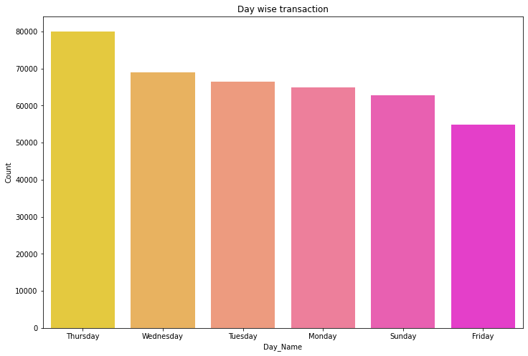
Customer Transaction Frequency Over Days
The bar chart illustrates customer transaction frequencies by day of the week.
Thursday records the highest transactions, followed by Wednesday and Tuesday.
Suggests an active period for customer purchases in the latter half of the week, possibly influenced by shopping patterns, restocking behaviors, or targeted promotions.
Absence of transactions on Saturday raises questions about potential data anomalies or a business model that does not operate on weekends.
Insights are crucial for scheduling promotions, staff, and inventory management to align with peak transaction days and investigate the reasons behind the lack of Saturday transactions.
Notes:
In this segment of our presentation, we'll delve into the insights gained from analyzing customer transaction frequencies by day of the week. The bar chart vividly illustrates that Thursday records the highest transactions, closely followed by Wednesday and Tuesday. This observation suggests an active period for customer purchases in the latter half of the week, potentially influenced by shopping patterns, restocking behaviors, or targeted promotions. However, the absence of transactions on Saturday raises questions about potential data anomalies or a business model that might not operate on weekends. These insights are of paramount importance for our business strategy. Understanding these transaction patterns is crucial for scheduling promotions, managing staff, and optimizing inventory. Aligning these operational aspects with peak transaction days is imperative to enhance overall efficiency and customer satisfaction. Additionally, investigating the reasons behind the lack of Saturday transactions will provide valuable information for potential adjustments in our business model or operational strategy.

Slide 11
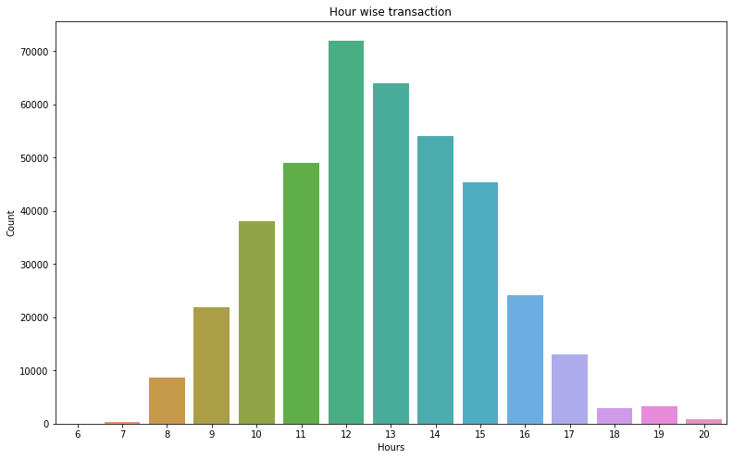
Distribution of Purchase Transaction by Hours
The bar chart displays the distribution of purchase transactions by hour of the day.
Notably, a peak in activity occurs between 12 PM and 3 PM.
This trend suggests customers are more inclined to make purchases during early to mid-afternoon hours, possibly tied to lunch breaks or increased shopping engagement.
Implications for Retailers:
Optimize marketing efforts with promotions, flash sales, or targeted communications during peak hours.
Align operational planning, including staffing, customer service, and logistics, with busier periods to enhance customer experience and efficiency.
Notes:
In this part of the presentation, our focus is on the insights drawn from the bar chart displaying the distribution of purchase transactions by the hour of the day. Notably, a discernible peak in activity is observed between 12 PM and 3 PM. This trend suggests that customers are more inclined to make purchases during the early to mid-afternoon hours, possibly influenced by lunch breaks or heightened shopping engagement. The implications for retailers are significant. To capitalize on this peak in customer activity, retailers can strategically optimize their marketing efforts by scheduling promotions, flash sales, or targeted communications during these peak hours. Furthermore, aligning operational planning with busier periods becomes crucial. This includes staffing, customer service availability, and logistics to enhance both customer experience and operational efficiency. By understanding and leveraging these trends, retailers can potentially boost sales, improve customer satisfaction, and optimize their overall business operations.

Slide 12
Modeling Approach
Exploration of Modeling Techniques:
Started with simpler, interpretable models as a foundation for predictive analytics.
Moved to classical models, balancing sophistication and interpretability.
Explored enhanced models, leveraging advanced machine learning techniques for deeper insights.
Performance Metrics and Visualization:
Employed diverse metrics for rigorous model evaluation, including accuracy, precision, recall, and F1-scores for classification tasks.
For regression tasks, used metrics like MSE, RMSE, or MAE.
Visualization through ROC curves, precision-recall curves, and scatter plots provided a nuanced understanding of each model's strengths and weaknesses.
Explored various customer segmentation methodologies, ranging from foundational to advanced algorithms.
Methodical progression from baseline models to more intricate techniques.
Notes:
In this section of the presentation, let's delve into our comprehensive exploration of various customer segmentation methodologies. Our approach involved a methodical progression from foundational to advanced algorithms, ensuring a thorough understanding of the model landscape. The exploration of modeling techniques began with the establishment of simpler, interpretable models as a solid foundation for predictive analytics. This was followed by the introduction of classical models, striking a balance between sophistication and interpretability. We then delved into enhanced models, leveraging advanced machine learning techniques for deeper insights into customer segmentation. To rigorously evaluate and compare each model's performance, we employed a diverse set of metrics, including accuracy, precision, recall, and F1-scores for classification tasks, and metrics like MSE, RMSE, or MAE for regression tasks. Visualization techniques, including ROC curves, precision-recall curves, and scatter plots, were utilized to provide a nuanced understanding of each model's strengths and weaknesses. This comprehensive approach allowed us to make informed decisions in selecting the most suitable model for our customer segmentation needs.

Slide 13
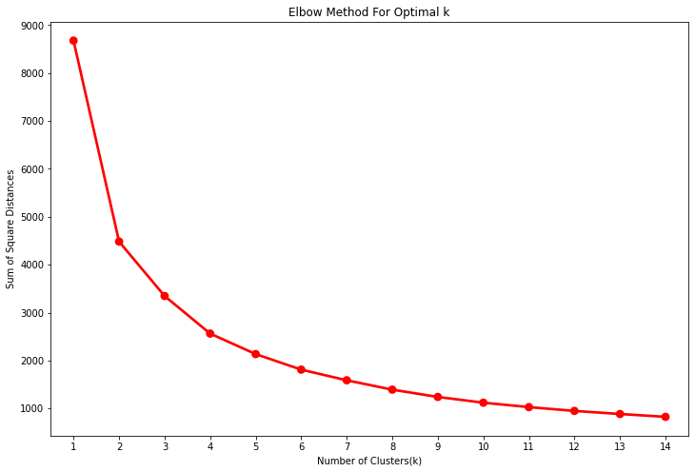
Model Evaluation
K-Means Clustering Evaluation
Utilized Silhouette Score for assessing clustering performance.
Silhouette score gauges object similarity to its cluster vs. other clusters (range: -1 to 1).
Applied K-Means clustering with different cluster numbers.
Silhouette scores crucial for determining ideal cluster count, indicating cohesion within clusters and separation between them.
Analysis involved identifying a plateau in score increment to reveal the most natural grouping in the data.
Notes:
In this part of the presentation, let's focus on the evaluation of our K-Means clustering approach. To assess the clustering performance, we employed the Silhouette Score, a metric that gauges the similarity of an object to its cluster compared to other clusters, with a range between -1 and 1. We applied K-Means clustering with varying cluster numbers and utilized Silhouette Scores as a crucial measure for determining the ideal cluster count. The scores play a pivotal role in indicating the cohesion within clusters and the separation between them. Our analysis involved closely examining the Silhouette Scores, with a specific focus on identifying a plateau in the score increment. This plateau signifies the most natural grouping in the data, assisting us in making informed decisions about the optimal number of clusters for our customer segmentation model.

Slide 14
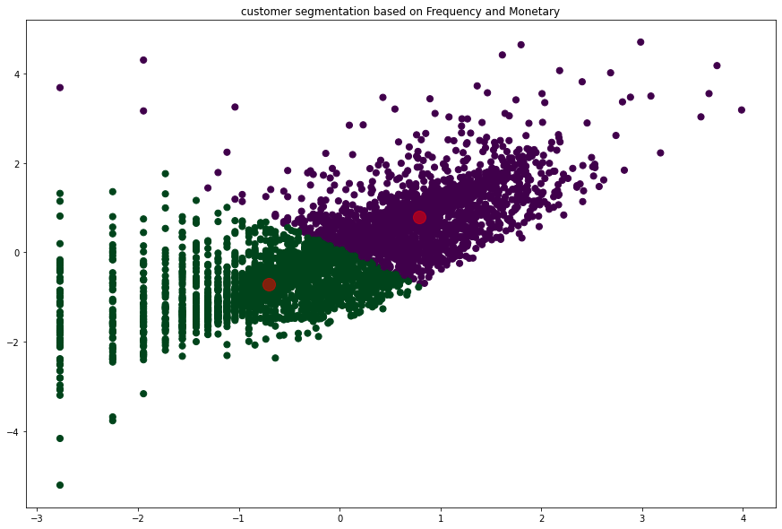
Elbow Method Analysis
Employed the elbow method to validate the optimal cluster count.
Plotted the sum of squared distances of samples to their nearest cluster center.
Identified the "elbow" point on the curve, indicating the suitable cluster count.
Elbow represents the number of clusters where within-cluster variation (inertia) minimally decreases.
Looked for a noticeable change in the plot's angle to determine the best number of clusters.
The inflection point signifies the most appropriate cluster count for the dataset.
Notes:
In this part of the presentation, let's focus on our utilization of the elbow method to validate the optimal cluster count for our segmentation model. To achieve this, we plotted the sum of squared distances of samples to their nearest cluster center, creating a distinct curve. The key aspect of this method involves identifying the "elbow" point on the curve, indicating the suitable cluster count. The elbow point corresponds to the number of clusters where within-cluster variation, known as inertia, minimally decreases. To pinpoint this optimal cluster count, we looked for a noticeable change in the plot's angle. The inflection point at which the angle changes significantly signifies the most appropriate cluster count for our dataset. This method offers a visual and intuitive way to determine the optimal number of clusters, providing a critical guide for our subsequent steps in the segmentation process.

Slide 15
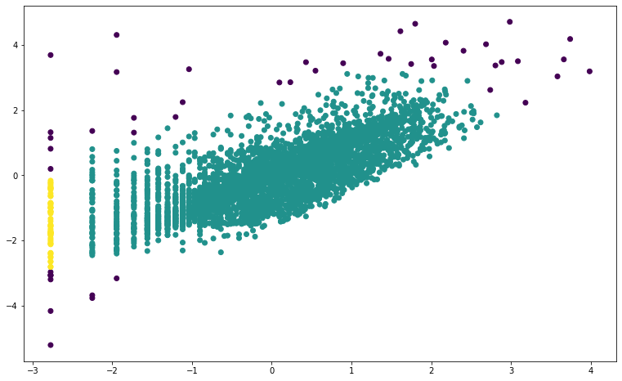
DBSCAN Clustering Evaluation
DBSCAN is a versatile clustering algorithm based on density, adept at finding irregularly shaped clusters and distinguishing noise.
Parameters set: EPS (neighborhood size) and min samples (minimum points for a cluster).
Applied DBSCAN in the project to evaluate its performance.
Evaluated clusters based on alignment with dense data regions, categorizing noise points as outliers.
DBSCAN results showcased clusters different from K-Means, potentially better for complex data distributions.
Choice between K-Means and DBSCAN depends on dataset characteristics; K-Means for globular clusters, DBSCAN for non-linear boundaries and varying densities.
Notes:
In this section of the presentation, let's delve into the evaluation of DBSCAN, a versatile clustering algorithm based on density. DBSCAN excels at identifying irregularly shaped clusters and effectively distinguishing noise within the data. We set key parameters, namely EPS (neighborhood size) and min_samples (minimum points for a cluster), and applied DBSCAN in our project to assess its performance. During the evaluation, we focused on how well the identified clusters aligned with dense data regions, while categorizing noise points as outliers. Notably, the results obtained from DBSCAN showcased clusters that differed from those generated by K-Means, hinting at its potential suitability for complex data distributions. The choice between K-Means and DBSCAN is contingent upon dataset characteristics; K-Means is apt for globular clusters, whereas DBSCAN is preferable for datasets with non-linear boundaries and varying densities. Understanding these distinctions allows us to make informed decisions regarding the clustering algorithm most aligned with our specific dataset and segmentation goals.

Slide 16
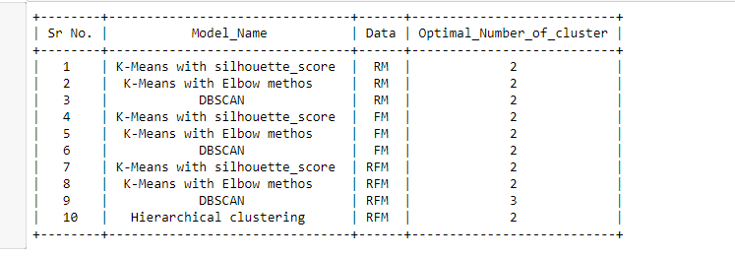
Model Selection
Explored clustering algorithms for a store specializing in all-occasion gifts.
Optimal cluster count determined as two through silhouette score analysis (score: 0.39).
Leveraged elbow method and DBSCAN for validation.
Concluded that K-Means algorithm, with its silhouette score, is most suitable for customer segmentation based on RFM analysis.
RFM analysis involves segmentation by recency, frequency, and monetary parameters.
Business can tailor services to each segment, potentially enhancing customer satisfaction and business success.
Notes:
In this segment of the presentation, let's delve into our exploration of clustering algorithms for a store specializing in all-occasion gifts. Through a meticulous analysis, we determined the optimal cluster count as two using silhouette score analysis, with a notable score of 0.39. To further validate our findings, we leveraged the elbow method and DBSCAN. Our comprehensive assessment led us to conclude that the K-Means algorithm, with its silhouette score, is the most suitable for customer segmentation, particularly based on RFM (Recency, Frequency, Monetary) analysis. RFM analysis involves segmenting customers based on their recency of purchase, frequency of transactions, and monetary value spent. This segmentation approach allows the business to tailor its services to each customer segment, potentially enhancing customer satisfaction and overall business success. These insights are invaluable for strategic decision-making and developing targeted marketing strategies, aligning the business with the specific needs and behaviors of each customer segment.

